Slide 1
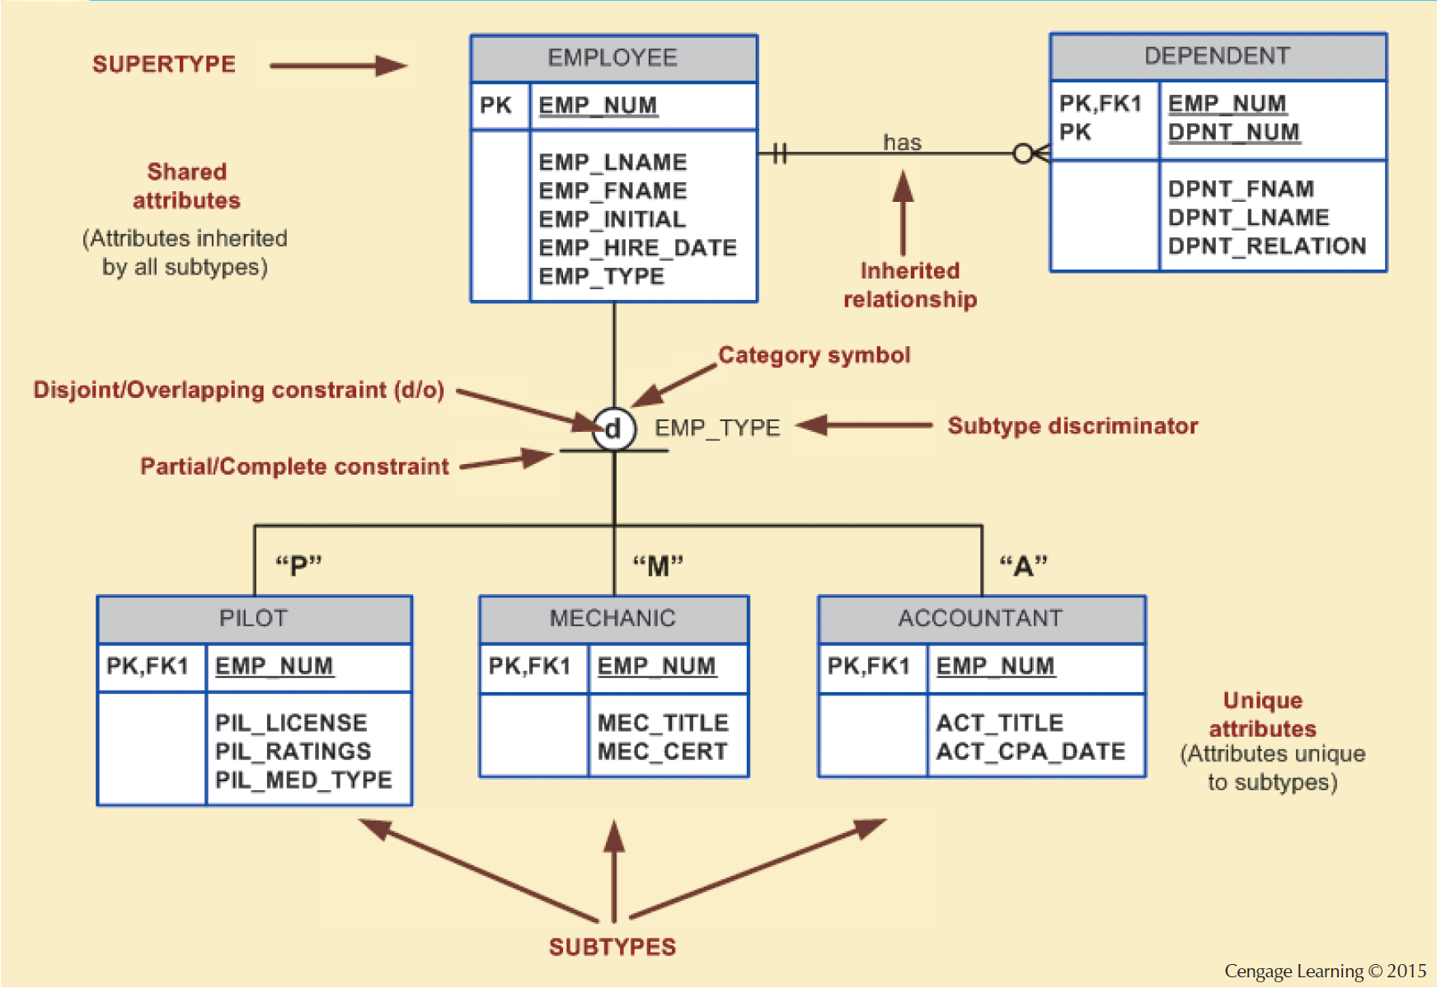
Figure 5.2 - Specialization Hierarchy

Slide 2
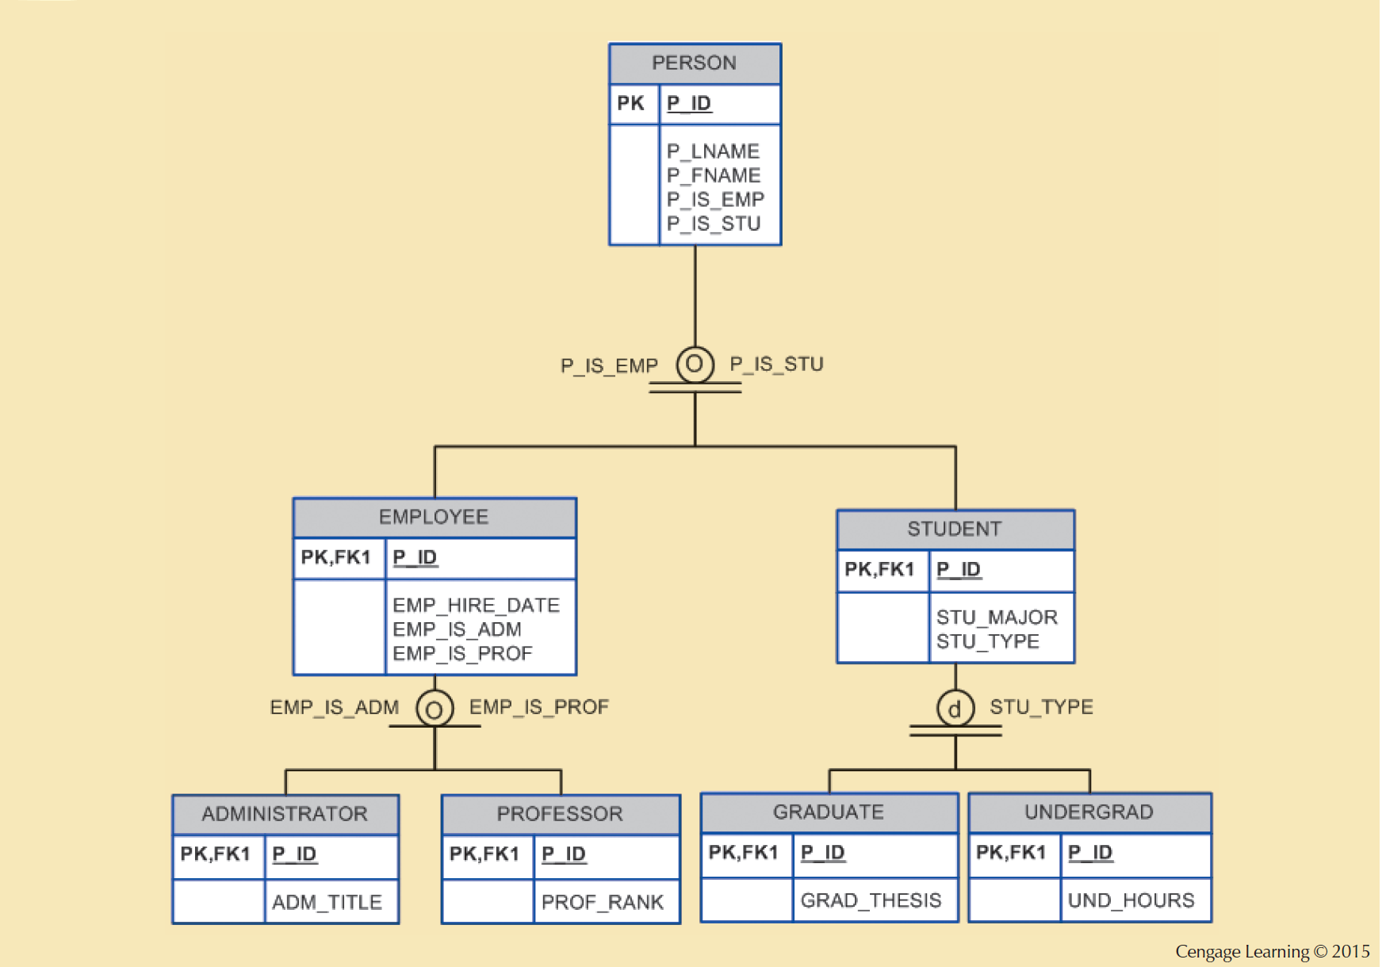
Figure 5.4 - Specialization Hierarchy with Overlapping Subtypes

Slide 3
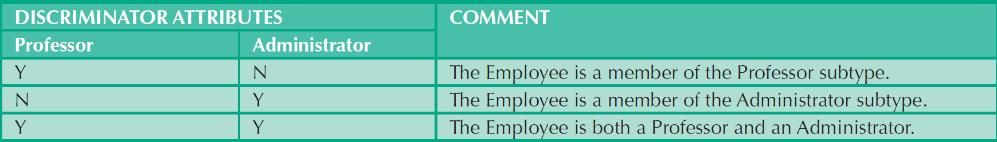
Table 5.1 - Discriminator Attributes with Overlapping Subtypes

Slide 4
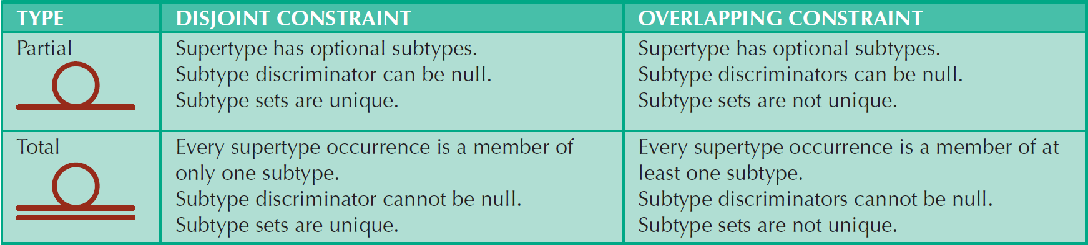
Table 5.2 - Specialization Hierarchy Constraint Scenarios

Slide 5
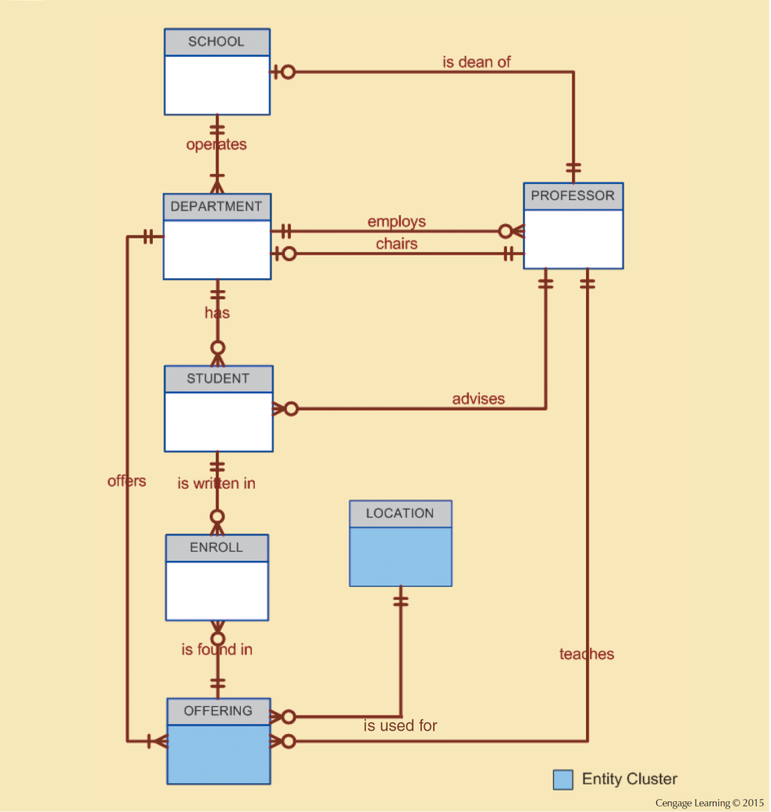
Figure 5.5 - Tiny College ERD Using Entity Clusters

Slide 6
Desirable Primary Key Characteristics
Non intelligent
No change over time
Preferably single-attribute
Preferably numeric
Security-compliant
Notes:
Non-intelligent

Slide 7
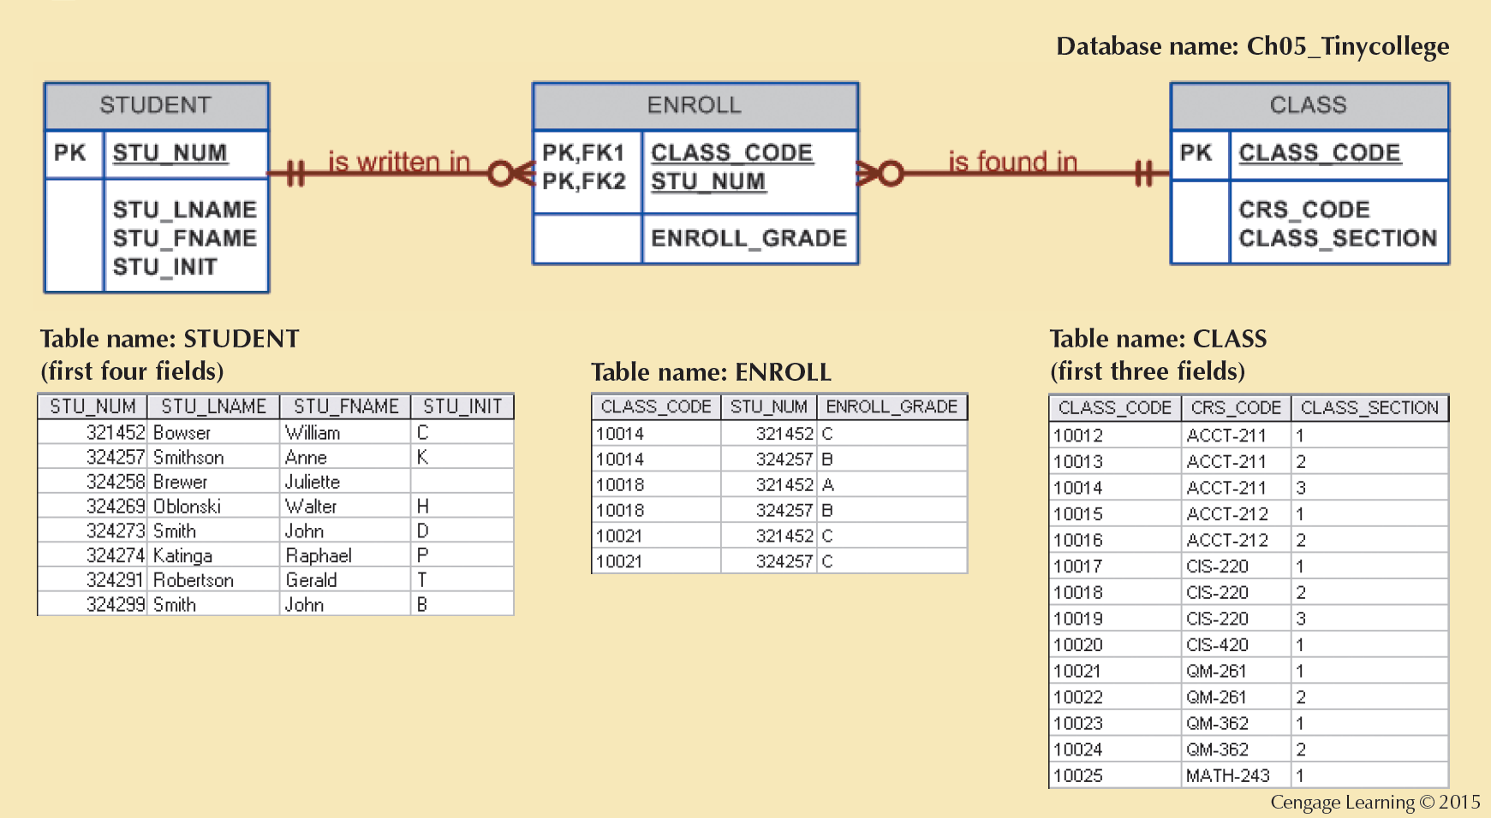
Figure 5.6 - The M:N Relationship between STUDENT and CLASS

Slide 8
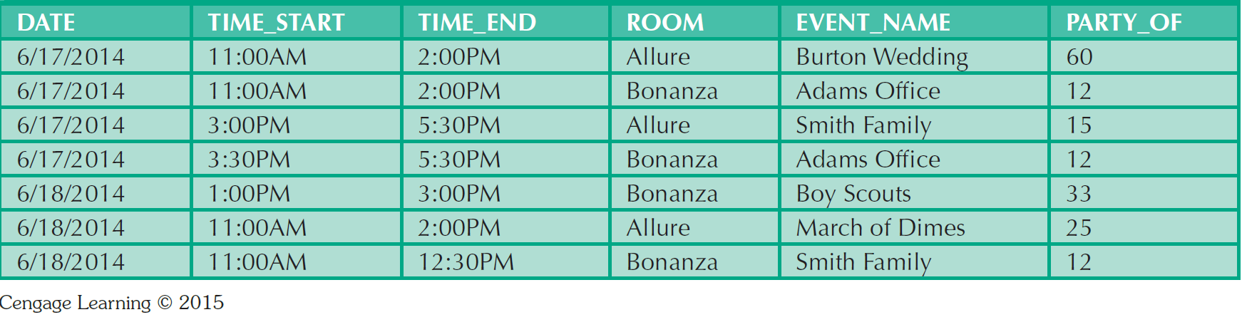
Table 5.4 - Data Used to Keep Track of Events

Slide 9
Table 5.5 - Selection of Foreign Key in a 1:1 Relationship
CASE | ER Relationship Constraint | Action
1 | One side is mandatory and the other side is optional | Place the PK of the entity on the mandatory side in the entity of the optional side as a FK, and make the FK mandatory.
2 | Both sides are optional. | Select the FK that causes the fewest NULLs, or place the FK in the entity in which the (relationship) role is played.
3 | Both sides are mandatory. | See case 2, or consider revising your model to ensure that the two entities do not belong together in a single entity.

Slide 10
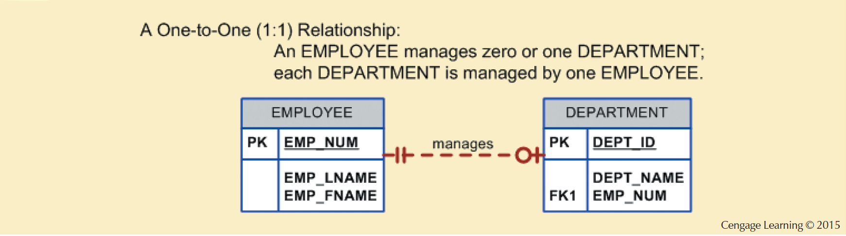
Figure 5.7 - The 1:1 Relationship between Department and Employee

Slide 11
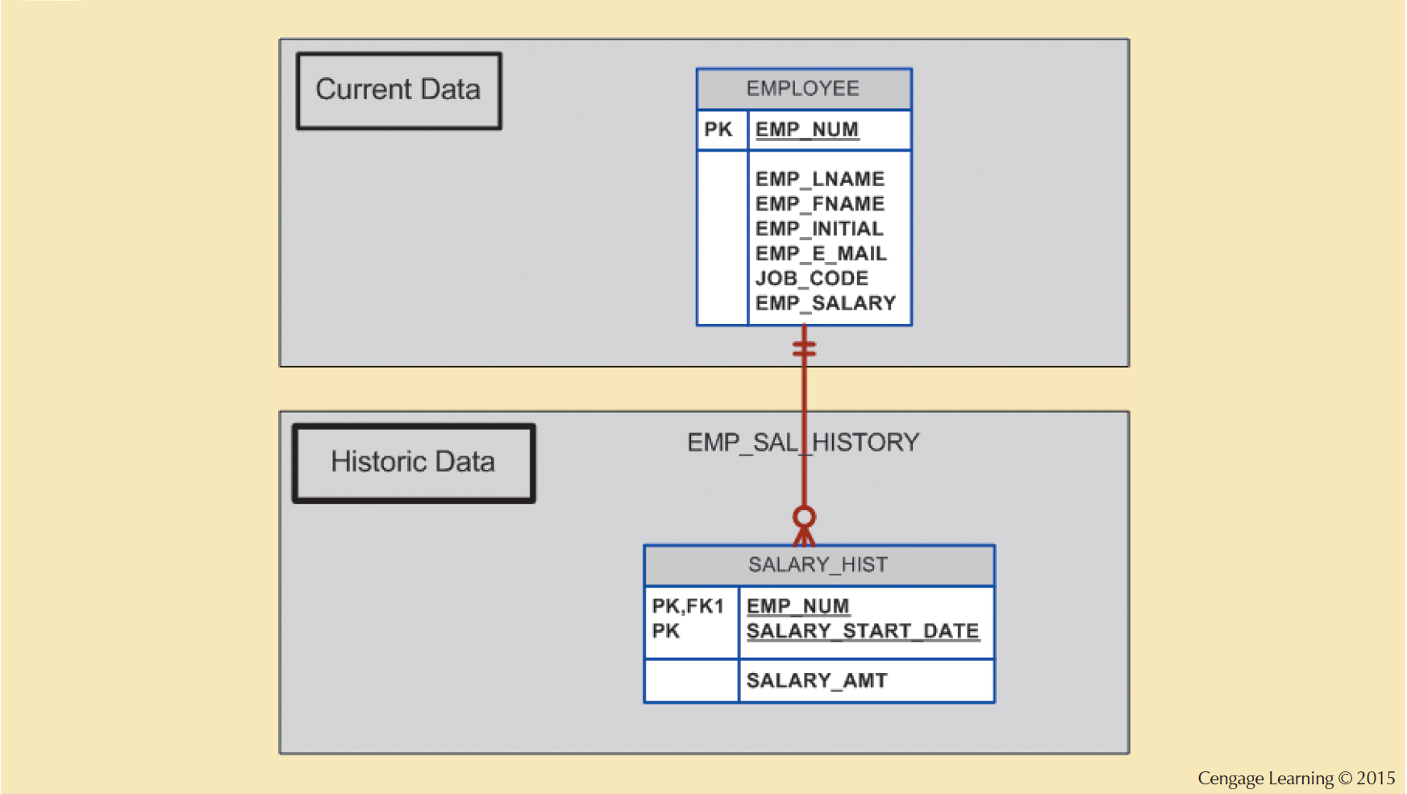
Figure 5.8 - Maintaining Salary History

Slide 12
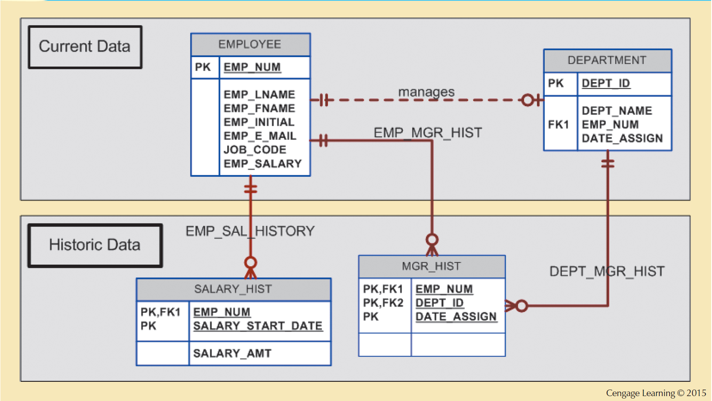
Figure 5.9 - Maintaining Manager History

Slide 13
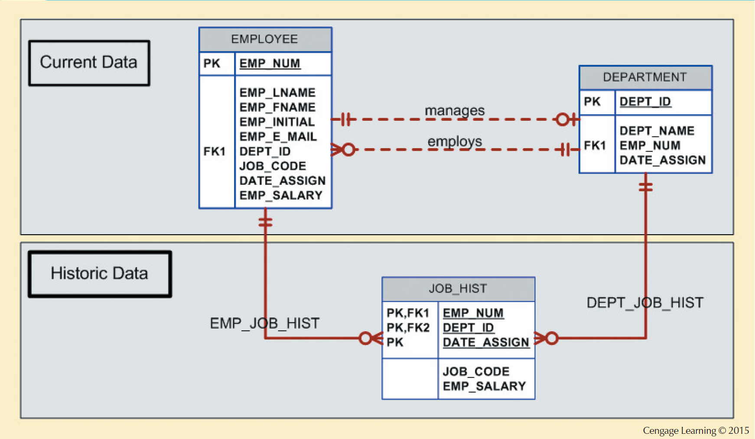
Figure 5.10 - Maintaining Job History

Slide 14
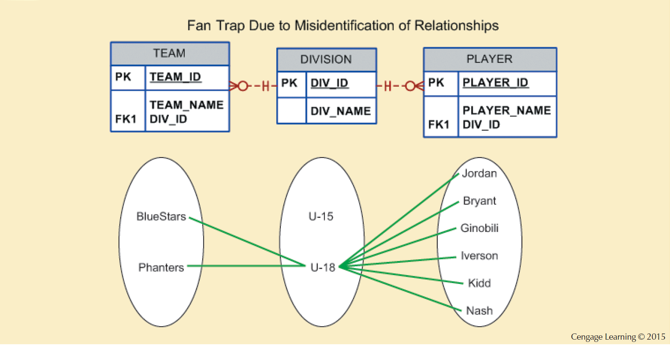
Figure 5.11 - Incorrect ERD with Fan Trap Problem
Notes:
This is ok, but there is no way to identify which players belong to which team.
Note that the relationship lines for the DIVISION instances fan out to the TEAM and PLAYER entity instances— thus the “ fan trap” label.

Slide 15
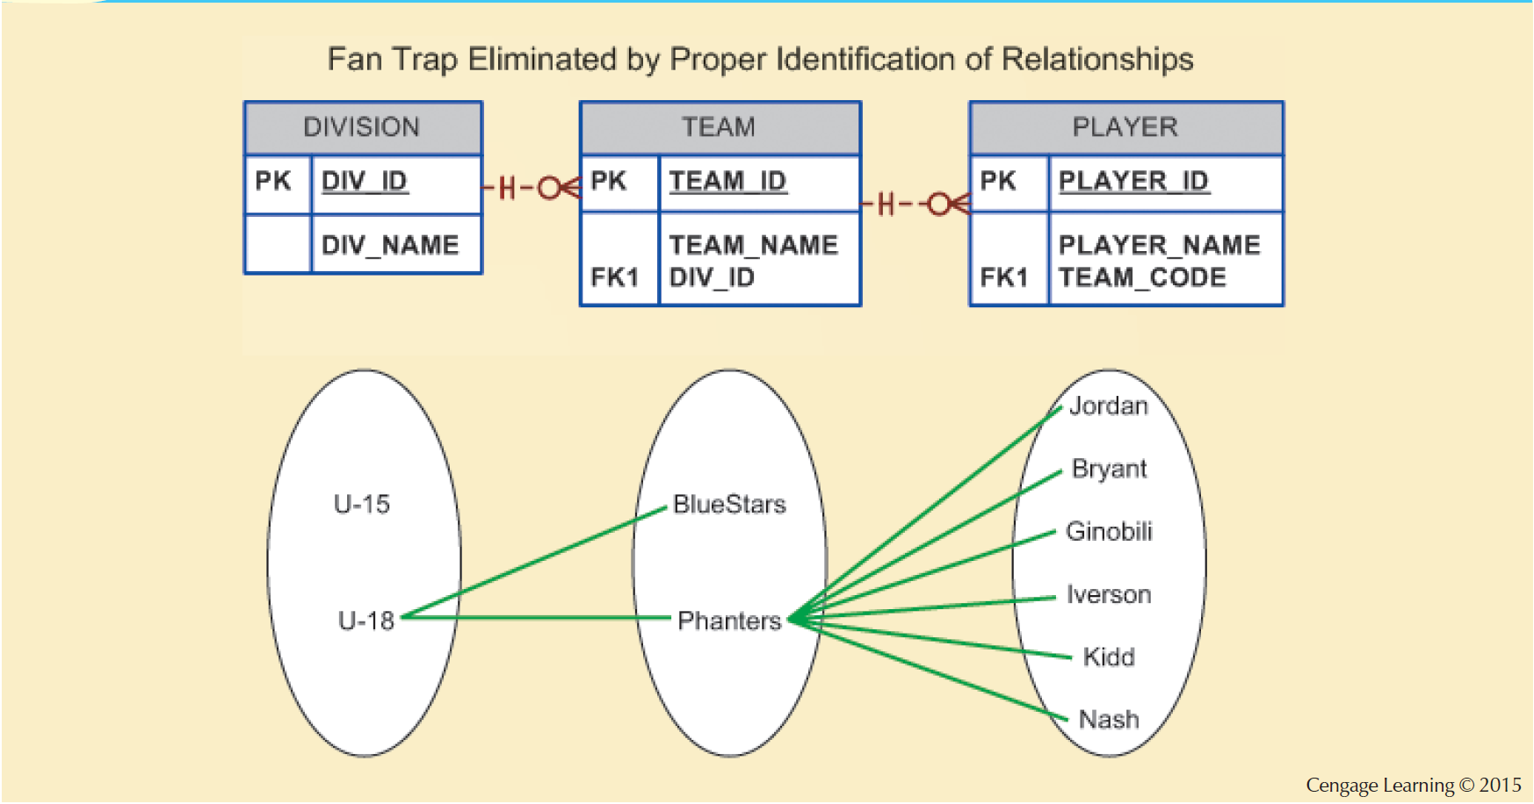
Figure 5.12 - Corrected ERD After Removal of the Fan Trap
Notes:
Here the fan trap is been eliminated by the proper identification of the relationships.
DIVISION is in a 1:M relationship with TEAM.
In turn, TEAM is in a 1:M relationship with PLAYER..

Slide 16
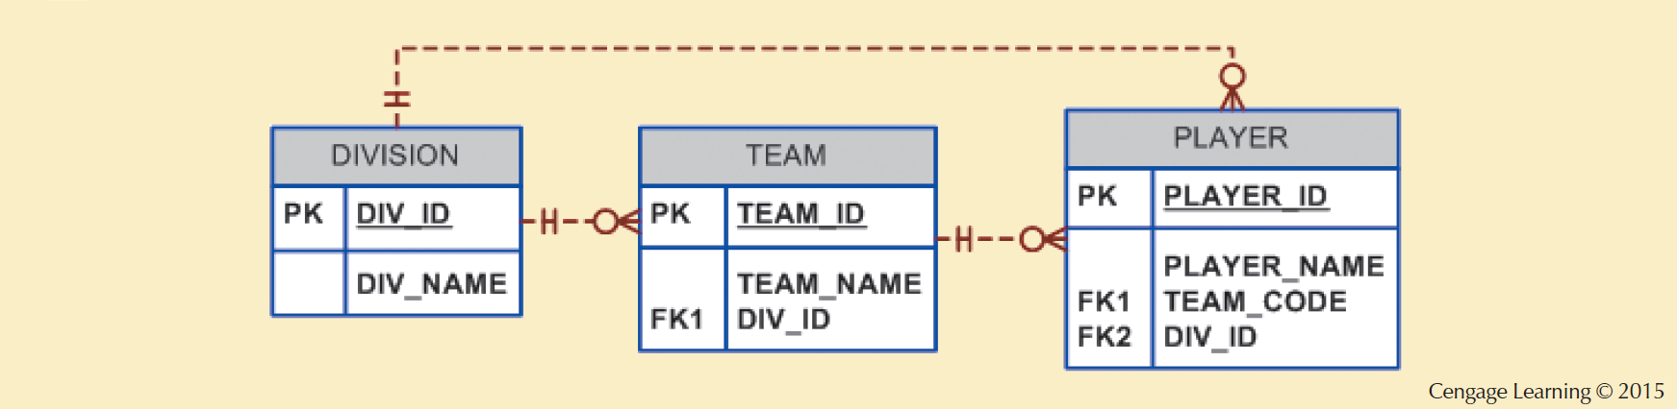
Figure 5.13 - A Redundant Relationship
Notes:
Note the transitive 1: M relationship between DIVISION and PLAYER through the TEAM entity set.
Therefore, the relationship that connects DIVISION and PLAYER is redundant, for all practical purposes.
In that case, the relationship could be safely deleted without losing any information- generation capabilities in the model.

